Slide 1
News Reading Through HCI
TBW Research Report

Slide 2
Team Members:

Slide 3
Introduction
Human computer interaction is considered a fundamental when designing a user interface for any software. News reading through machines is no exception.
This research is a gateway to making news more appealing to the general public, thereby, increasing the number of active news readers.

Slide 4


The Downfall of News Readers
With the advent of technology, Newspapers have been pushed back in the queue of things which provide education.
Newspapers still remains as of the important ways through which valuable information can be achieved.
There are many reasons which are to blame for the downfall of news reading and HCI can be used to counter them.

Slide 5

What is HCI?
HCI stands for Human Computer Interaction.
It researches the design and use of computer technology, focusing on the interfaces between people (users) and computers.
Researchers in the field of HCI both observe the ways in which humans interact with computers and design technologies that let humans interact with computers in novel ways.

Slide 6



Research Question
What are the variables because of which the amount of news readers have fallen down?
How to solve the problem of downfall of news readers with the help of HCI?

Slide 7

Literature Review
Following are the key points that we discovered by reviewing the literature in the relevant field of study:
1. Newspapers have become dull and boring due to obvious reasons - Cleghorn, Reese. "Why are so many newspapers boring?"
2. News with just text is not appealing enough to capture a large audience, to make it more appealing an integrated, coherent model of human information processing is required. - John and Newell, 1989

Slide 8
Continued
The layout of the news matters a lot as it affects what people remember from it. The Experiment done by selecting two different news sites, classic and contemporary showed that later was chosen more and reported more than 90% more unique page views. - The Engaging News Project - Natalie Jomini Stroud, Alex Curry, Arielle Cardona, and Cynthia Peacock
Other than the visual effects, the length of the news also matters a lot as the experiments showed that the short news features were the most fully read objects in the newspaper - The role of local design factors for newspaper reading behavior - Kenneth Holmqvist and Constanze Wartenberg

Slide 9


Objective : The Objectives of this study is to make news reading interesting and engaging for the modern day populace.
Significance : People rely on the news and constantly seek more of it, to learn new information and to seek reassurance amidst feelings of fear and uncertainty. Modern day readers seek less reading and more information on their menu.

Slide 10

Limitations
This research is limited to only the visual (and auditory) perspective of the news. This study is only limited to making the news precise and engaging using the principles of HCI.
Also it is highly important that we are able to deduce the inner workings of the mind for our research to have significant impact. We are limited by the knowledge that there currently is of the human psyche.

Slide 11
Research Methodology
This research is based on quantitative data that we have obtained through surveys from people between the ages of 15-40 living in Karachi, Pakistan.
Sampling Technique
Survey was conducted on people between the ages of 15-40, 77% of which are university students, 12% are school going, and the rest 11% are people doing jobs.

Slide 12
Research Instrument
The key variables in this study were measured by a self-report questionnaire.
It consisted of two parts:
1. The Demographic Information.
2. Questions to research the Hypothesis.
It contained 15 questions which queried the respondent regarding the Hypothesis.

Slide 13

Ethical Consideration: It is ensured that the information provided by the respondents will be used only for the purpose of data analysis. No personal benefit, whatsoever, will ever be gained neither will the information be passed on to any other institutions or organizations to access the sample for any reason.
Research Procedure: We randomly selected about 50 people each from our own social network. We took a survey (which we designed based on our research).

Slide 14
Findings

Slide 15


Demographic Information
The respondents had the following demographic information:
They were all Students.
Average age of the respondents is 21.
9 out of 51 students were female.

Slide 16
39.2 %
The percentage of people who said that they do not read newspapers.
This implies that there are people who have started to stop reading newspapers.

Slide 17
Do You feel uninterested while reading the newspaper?
This result seconds our hypothesis that there is a need for making newspapers more interesting.

Slide 18
Do You think newspaper should be made more engaging?
This result show that attempt should be made to make the newspaper more engaging.

Slide 19


Important Features of an engaging Newspaper
1. Color Scheme:
42/51
The amount of people who find color scheme as an important feature for a newspaper.
1. Categorization:
44/51
The amount of people who think that categorizing the news makes it convenient for them to read newspaper.

Slide 20
How long (in paragraphs) should be an Article?
3
The no of paragraphs that are enough for an article. This result was gained by computing the average of all the responses given by the respondents.
This implies that people are interested in reading short articles rather than longer ones.

Slide 21
Methods to make News More Captivating

Slide 22

Slide Show
66.7 %
The percentage of people who said that they would like to see the news as a slideshow.

Slide 23
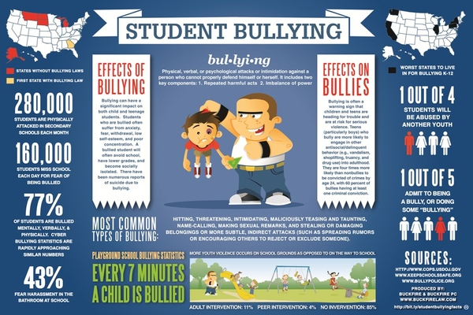
Infographics
Infographics are graphic visual representations of information, data or knowledge intended to present information quickly and clearly.
An example of an infographic regarding Student Bullying

Slide 24
Would you like to see news as Infographics?
Infographic is a modern approach for dictating information and people are interested in seeing news in the form of it.

Slide 25

Tell Us your Suggestion
We asked the respondents to reply with a suggestion through which news can be made more engaging. Following are a few of them:
NImR1 said : “By using Colored Newspaper”.
NmR2 said : “Include Infographics and more engaging content”.
ZmR3 said : “By adding more categories to it”.
NSfR4 said : “By adding more colorful pictures”.
The above suggestion seconds with our analysis of data.

Slide 26
Conclusion
The Downfall of Newspaper readers is imminent.
The use of Principles of HCI are vital for the survival of newspapers.
The Data was taken from Students in the age gap of 21-25 for the research report.
The results brought ways through which news reading can gain increase.
Categorization and Color Schemes should be focused on to make newspapers more engaging.

Slide 27
Recommendations:
The newspaper should have a better color scheme with more colors.
The amount of images related to the article should be increased.
News should be presented in a categorized manner such that each category of the news should be presented on a different page.
Attempts should be made such that the Info-graphics could be included which can convey the information in a better way

Slide 28
Thank You!

